Slide 1
A Novel Approach to Outlier-Aware K-means Clustering
Quarter 2 Project
Dhruv Chandna & Soham Jain
Dr. Yilmaz
Period 6
02/05/2025
Notes:
D

Slide 2
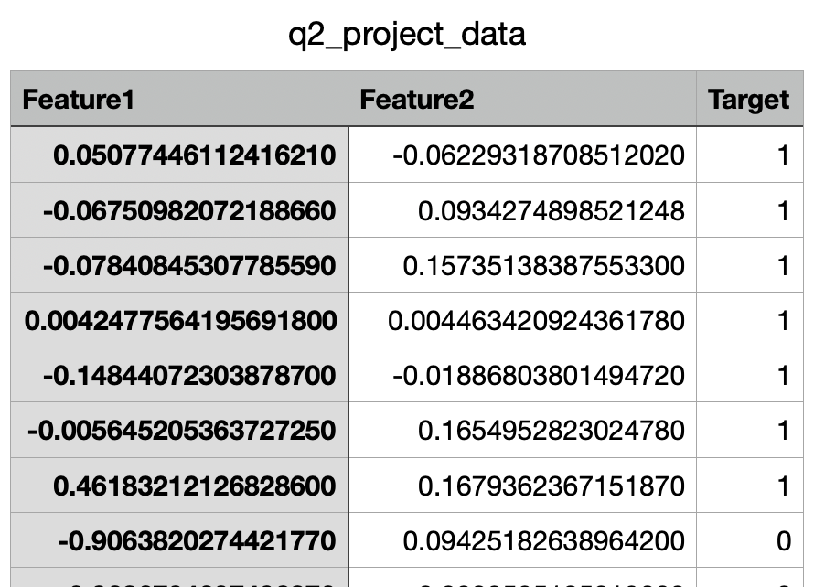
Background
Created our own dataset with 450 instances
Input: CSV containing values for 2 quantitative continuous features
Output: Target classification (0 or 1) using a novel, outlier-aware K-means clustering algorithm
…
…
…
Input
Notes:
D

Slide 3
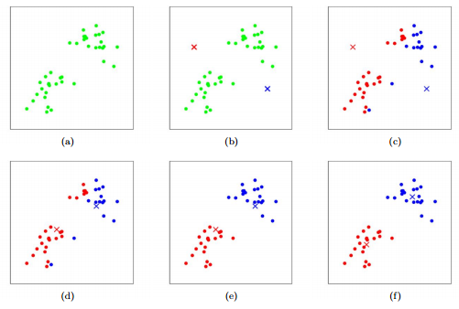
Background: K-means
Calculates Euclidean distances between data points
Uses mean value as the new centroid
Problem: sensitivity to outliers
k = 2:
Notes:
S

Slide 4
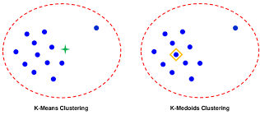
Background: K-medians
Instead of mean, the measure of center is median
Resistant to outliers
Problem: Poor representation of varying/split data clusters
Notes:
D

Slide 5
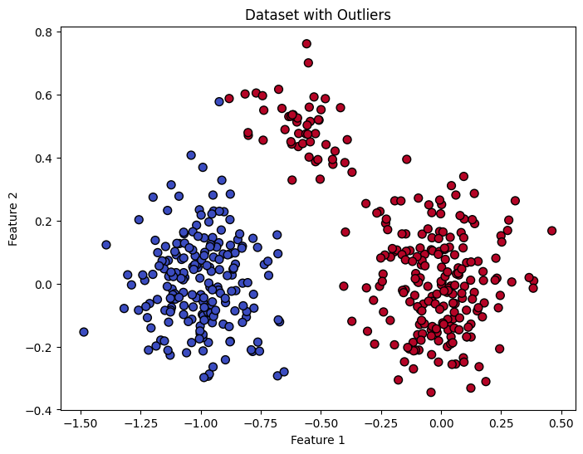
Dataset
450 total instances
Two large clusters of 200 instances for each class
One cluster with 50 instances in between
Notes:
D

Slide 6
Related Work
Song (2024)
89% accuracy with K-means on iris dataset
Limitation: Sensitivity to outliers and variance
Zhang et al. (2020); Olukanmi and Twala (2017)
Applied K-means after removing all outliers
Limitation: loss of information
Notes:
S

Slide 7
Methods
We propose a clustering algorithm that accounts for outliers without needing to completely remove them
Weighted mean for setting new centroid locations
Hybrid integration of K-means with K-medians
Notes:
D

Slide 8
Methods: Our Algorithm
(x_{f} , y_{f} , …) = (1 - λ) • (x_{mean}, y_{mean}, …) + λ • (x_{median}, y_{median}, …)
Weight
Centroid calculated with K-means
Centroid calculated with K-medians
New centroid
Notes:
D

Slide 9

Methods: Weight Calculation
Ratio between outliers and total number of instances
Cube root to amplify the weight
Weight ranges between 0 and 1
λ =
# of outliers
# of instances
Weight
Notes:
D

Slide 10
Results: Performance Metrics
Accuracy, Precision, Recall, F1-score
Created our own performance metric called “homogeneity” to measure how much of a cluster belongs to the same class
Homogeneity = (max count of a label in C) / (total points in C), where C is the cluster
Confusion matrix
Notes:
S

Slide 11
Results: Performance Metrics
K-means:
Precision: 0.9065
Recall: 0.9080
F1-Score: 0.8978
Accuracy: 0.8978
Cluster 1 Homogeneity: 1.0
Cluster 2 Homogeneity: 0.813
Outlier-Aware K-means:
Precision: 0.9115
Recall: 0.9140
F1-Score: 0.9044
Accuracy: 0.9044
Cluster 1 Homogeneity: 1.0
Cluster 2 Homogeneity: 0.823
Notes:
S

Slide 12
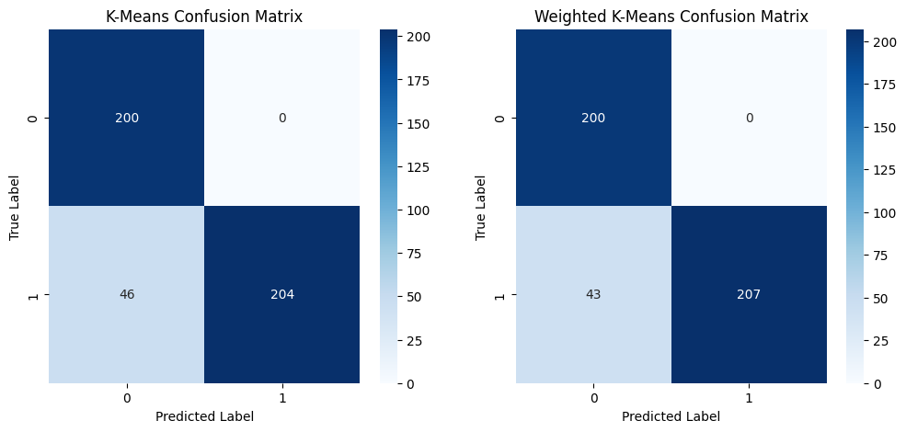
Results: Confusion Matrices
Notes:
S

Slide 13
Conclusion
Our Outlier-Aware K-means algorithm improves performance compared to standard K-means in datasets with outliers.
The weighted integration of K-means and K-medians allows for better cluster homogeneity without completely discarding outliers.
Performance metrics, including accuracy and F1-score, show a slight improvement over traditional K-means.
Notes:
S

Slide 14
Future Work
Test our model on real-world datasets with higher dimensionality (e.g. iris, diabetes, etc.)
Explore other adaptive weighting strategies to dynamically adjust outlier influence
Notes:
S

Slide 15
References
https://stanford.edu/~cpiech/cs221/handouts/kmeans.html
https://www.researchgate.net/publication/380208588_Research_on_clustering_algorithms_based_on_the_Iris_dataset
https://onlinelibrary.wiley.com/doi/10.1155/2020/3650926
https://ieeexplore.ieee.org/document/8261116

